Slide 1
SLAM-MR Simultaneous Localization and Mapping with Multiple Robots
Hammad Izhar and Thomas Kaminsky CS 2620 Final Presentation

Slide 2
Simultaneous Localization and Mapping

Slide 3
Simultaneous Localization and Mapping
Problem Setting:

Slide 4
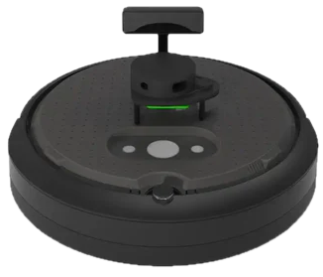
Simultaneous Localization and Mapping
Problem Setting:
Robot(s)

Slide 5

Simultaneous Localization and Mapping
Problem Setting:
Robot(s)
Sensor(s)

Slide 6
Simultaneous Localization and Mapping
RGB(D) Camera
Problem Setting:
Robot(s)
Sensor(s)

Slide 7
Simultaneous Localization and Mapping
RGB(D) Camera
Problem Setting:
Robot(s)
Sensor(s)
LIDAR

Slide 8
Simultaneous Localization and Mapping
RGB(D) Camera
Problem Setting:
Robot(s)
Sensor(s)
LIDAR
RADAR/SONAR

Slide 9
Simultaneous Localization and Mapping
Problem Setting:
Robot(s)
Sensor(s)
Odometry

Slide 10
Simultaneous Localization and Mapping
Problem Setting:
Robot(s)
Sensor(s)
Odometry
Goal:

Slide 11
Simultaneous Localization and Mapping
Problem Setting:
Robot(s)
Sensor(s)
Odometry
Goal:
Maintain a ‘map’ of the environment and your ‘location’ within it

Slide 12
Simultaneous Localization and Mapping
Problem Setting:
Robot(s)
Sensor(s)
Odometry
Goal:
Maintain a ‘map’ of the environment and your ‘location’ within it
Point Clouds
Locations of interesting objects
Walls

Slide 13
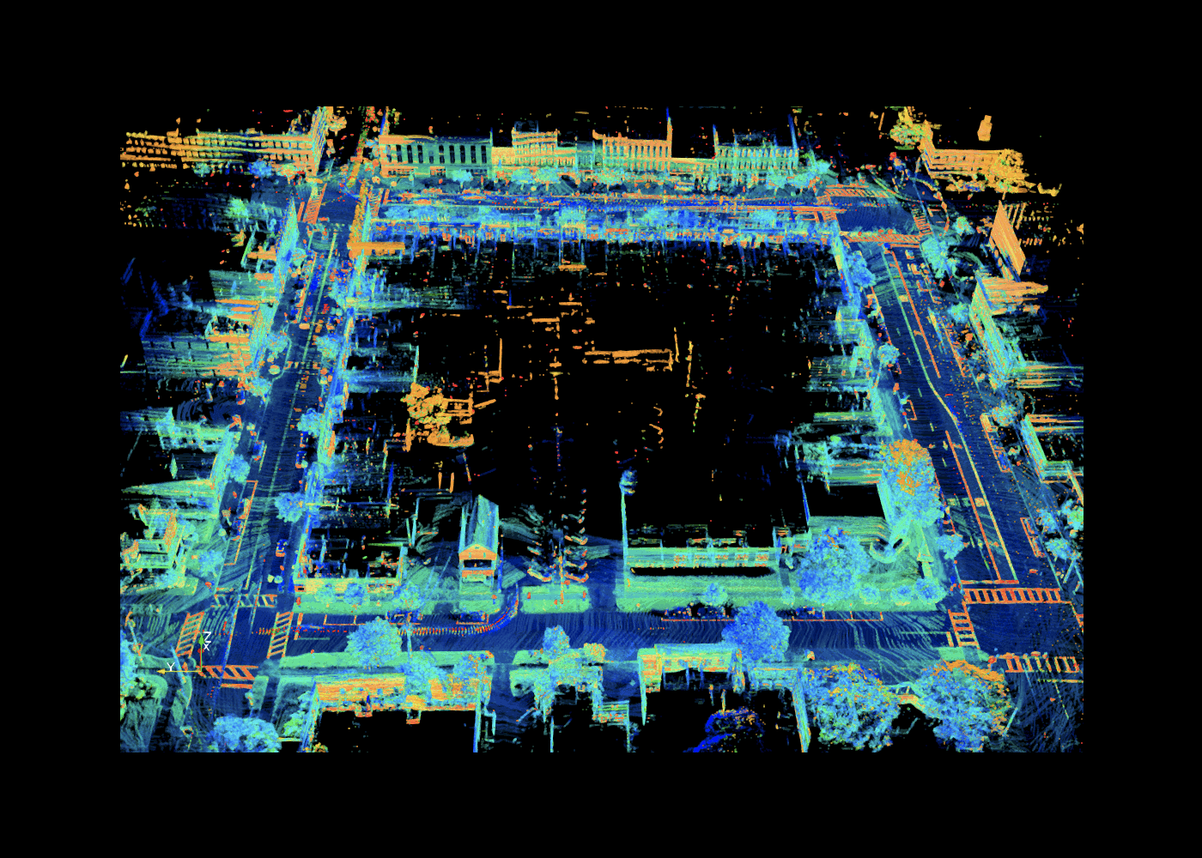
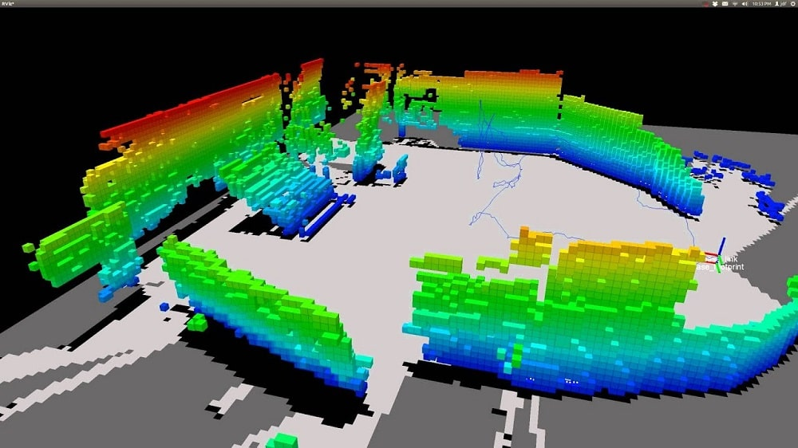
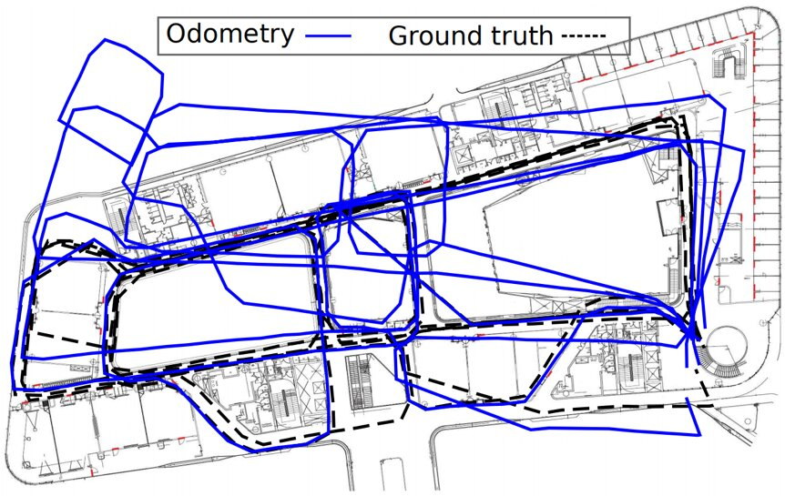
Simultaneous Localization and Mapping
Problem Setting:
Robot(s)
Sensor(s)
Odometry
Goal:
Maintain a ‘map’ of the environment and your ‘location’ within it
Point Clouds
Locations of interesting objects
Walls

Slide 14
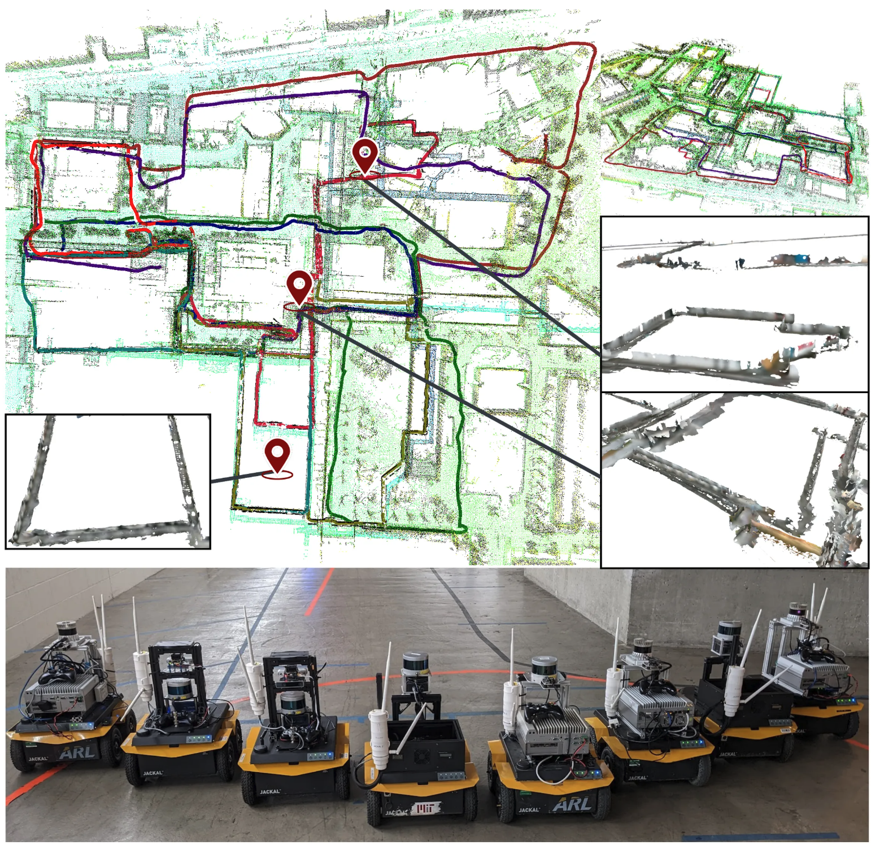
Multi-Robot SLAM
Benefits:

Slide 15
Multi-Robot SLAM
Benefits:
More sensors + parallelization

Slide 16
Multi-Robot SLAM
Benefits:
More sensors + parallelization
Exploring with different capabilities

Slide 17
Multi-Robot SLAM
Benefits:
More sensors + parallelization
Exploring with different capabilities
Challenges

Slide 18
Multi-Robot SLAM
Benefits:
More sensors + parallelization
Exploring with different capabilities
Challenges
Multiple Reference Frames

Slide 19
Multi-Robot SLAM
Benefits:
More sensors + parallelization
Exploring with different capabilities
Challenges
Multiple Reference Frames
Communication costs

Slide 20
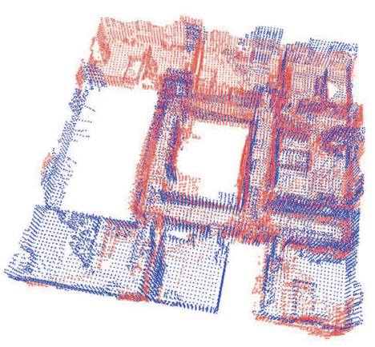
Distributed PGO
Choudhary et al. (2017): Distributed Mapping with Privacy and Communication Constraints
Each robot does single-agent SLAM
During rendezvous with other robots:
Neighbors exchange sensed relative poses
Two rounds of distributed linear optimization (SOR) estimate:
Global Rotation
Global Translation
Point clouds can then be mapped to the common frame

Slide 21
Distributed PGO
Choudhary et al. (2017): Distributed Mapping with Privacy and Communication Constraints
Each robot does single-agent SLAM
During rendezvous with other robots:
Neighbors exchange sensed relative poses
Two rounds of distributed linear optimization (SOR) estimate:
Global Rotation
Global Translation
Point clouds can then be mapped to the common frame

Slide 22
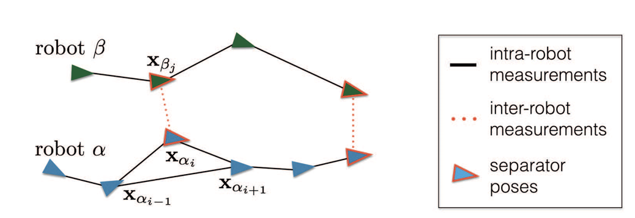
Distributed PGO
Choudhary et al. (2017): Distributed Mapping with Privacy and Communication Constraints
Each robot does single-agent SLAM
During rendezvous with other robots:
Neighbors exchange sensed relative poses
Two rounds of distributed linear optimization (SOR) estimate:
Global Rotation
Global Translation
Point clouds can then be mapped to the common frame

Slide 23
Distributed PGO
Choudhary et al. (2017): Distributed Mapping with Privacy and Communication Constraints
Each robot does single-agent SLAM
During rendezvous with other robots:
Neighbors exchange sensed relative poses
Two rounds of distributed linear optimization (SOR) estimate:
Global Rotation
Global Translation
Point clouds can then be mapped to the common frame

Slide 24
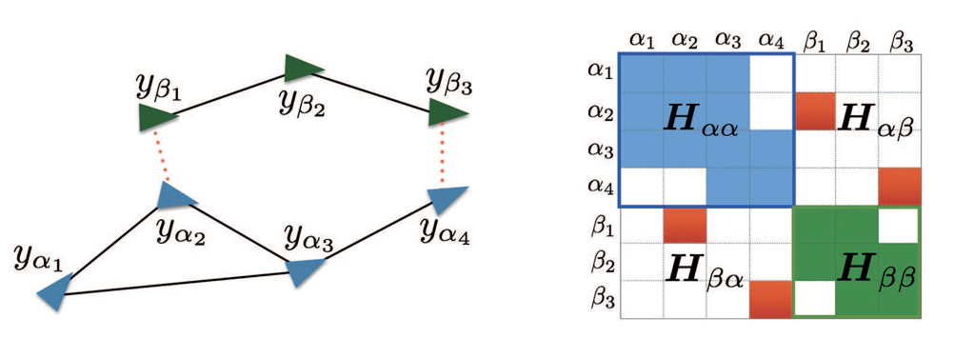
Distributed PGO
Choudhary et al. (2017): Distributed Mapping with Privacy and Communication Constraints
Each robot does single-agent SLAM
During rendezvous with other robots:
Neighbors exchange sensed relative poses
Two rounds of distributed linear optimization (SOR) estimate:
Global Rotation
Global Translation
Point clouds can then be mapped to the common frame

Slide 25
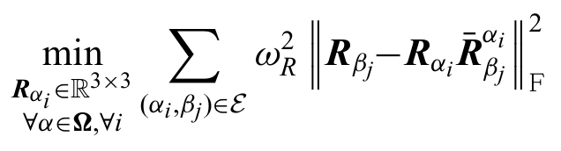
Distributed PGO
Choudhary et al. (2017): Distributed Mapping with Privacy and Communication Constraints
Each robot does single-agent SLAM
During rendezvous with other robots:
Neighbors exchange sensed relative poses
Two rounds of distributed linear optimization (SOR) estimate:
Global Rotation
Global Translation
Point clouds can then be mapped to the common frame

Slide 26
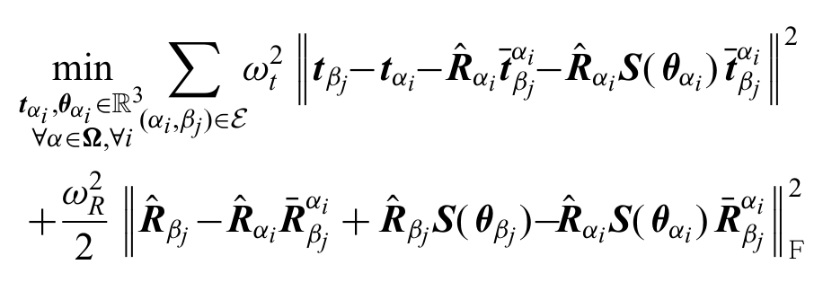
Distributed PGO
Choudhary et al. (2017): Distributed Mapping with Privacy and Communication Constraints
Each robot does single-agent SLAM
During rendezvous with other robots:
Neighbors exchange sensed relative poses
Two rounds of distributed linear optimization (SOR) estimate:
Global Rotation
Global Translation
Point clouds can then be mapped to the common frame

Slide 27
Distributed PGO
Choudhary et al. (2017): Distributed Mapping with Privacy and Communication Constraints
Each robot does single-agent SLAM
During rendezvous with other robots:
Neighbors exchange sensed relative poses
Two rounds of distributed linear optimization (SOR) estimate:
Global Rotation
Global Translation
Point clouds can then be mapped to the common frame

Slide 28
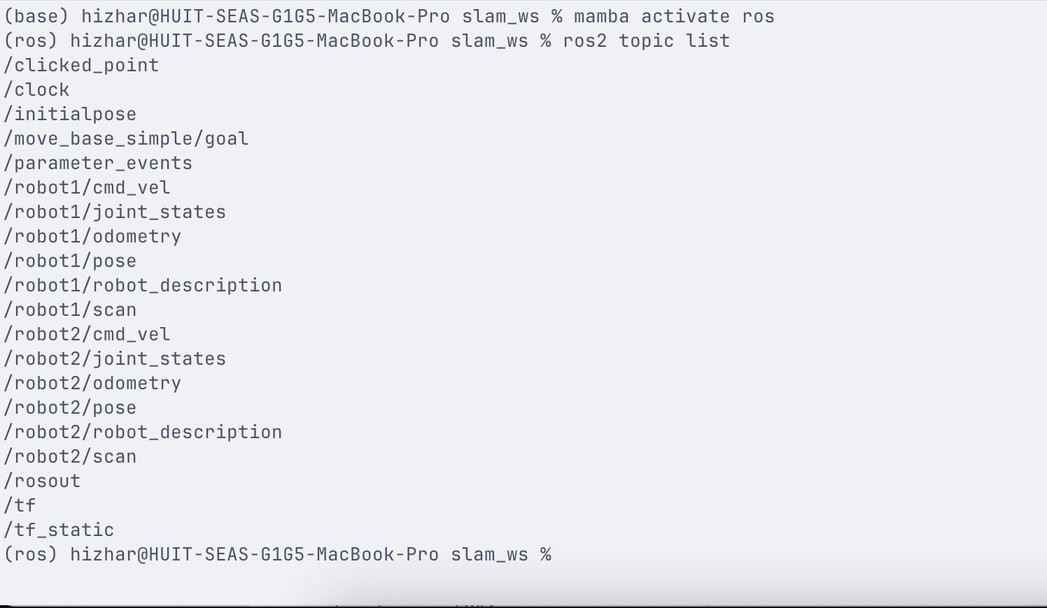
Our System
Communication via ROS
Physics simulated using Gazebo and maps visualized in RViz
Right now, solution is in software
Gazebo forces ‘physical realizability’ — all communication is performed via ROS topics
Should ease transition to hardware

Slide 29
Our System
Communication via ROS
Physics simulated using Gazebo and maps visualized in RViz
Right now, solution is in software
Gazebo forces ‘physical realizability’ — all communication is performed via ROS topics
Should ease transition to hardware

Slide 30
Our System
Communication via ROS
Physics simulated using Gazebo and maps visualized in RViz
Right now, solution is in software
Gazebo forces ‘physical realizability’ — all communication is performed via ROS topics
Should ease transition to hardware

Slide 31
Crash Course in ROS Communications
Misnomer — not actually an operating system, but rather a distributed message passing service
Executed code units are referred to as ‘nodes’
Nodes can communicate with one another via ‘topics’
Many-to-Many Publisher/Subscriber Model
Topics publish a single type of message
Custom messages can be defined via an IDL, similar to gRPC messages

Slide 32
Crash Course in ROS Communications
Misnomer — not actually an operating system, but rather a distributed message passing service
Executed code units are referred to as ‘nodes’
Nodes can communicate with one another via ‘topics’
Many-to-Many Publisher/Subscriber Model
Topics publish a single type of message
Custom messages can be defined via an IDL, similar to gRPC messages

Slide 33
Crash Course in ROS Communications
Misnomer — not actually an operating system, but rather a distributed message passing service
Executed code units are referred to as ‘nodes’
Nodes can communicate with one another via ‘topics’
Many-to-Many Publisher/Subscriber Model
Topics publish a single type of message
Custom messages can be defined via an IDL, similar to gRPC messages

Slide 34
Crash Course in ROS Communications
Misnomer — not actually an operating system, but rather a distributed message passing service
Executed code units are referred to as ‘nodes’
Nodes can communicate with one another via ‘topics’
Many-to-Many Publisher/Subscriber Model
Topics publish a single type of message
Custom messages can be defined via an IDL, similar to gRPC messages

Slide 35
System Communication Setup
Every robot is associated with a node in its own namespace
Simulate UDP multicast – when a new robot spins up, it broadcasts itself to the entire team on the /team topic allowing other nodes to subscribe to its position estimates
Every thirty seconds from startup, a robot attempts to rendezvous with its nearby neighbors by broadcasting a custom `BeginRendezvous` message on the /rendezvous topic

Slide 36
System Communication Setup
Every robot is associated with a node in its own namespace
Simulate UDP multicast – when a new robot spins up, it broadcasts itself to the entire team on the /team topic allowing other nodes to subscribe to its position estimates
Every thirty seconds from startup, a robot attempts to rendezvous with its nearby neighbors by broadcasting a custom `BeginRendezvous` message on the /rendezvous topic

Slide 37
System Communication Setup
Every robot is associated with a node in its own namespace
Simulate UDP multicast – when a new robot spins up, it broadcasts itself to the entire team on the /team topic allowing other nodes to subscribe to its position estimates
Every thirty seconds from startup, a robot attempts to rendezvous with its nearby neighbors by broadcasting a custom BeginRendezvous message on the /rendezvous topic

Slide 38
High Level Overview of Distributed PGO
A robot requires:

Slide 39
High Level Overview of Distributed PGO
A robot requires:
Sensed relative pose of their neighbors with respect to their current reference frame (/<neighbor_namespace>/pose)

Slide 40
High Level Overview of Distributed PGO
A robot requires:
Sensed relative pose of their neighbors with respect to their current reference frame (/<neighbor_namespace>/pose)
Sensed relative pose of themselves with respect to their neighbors (/<neighbor_namespace>/local_pose_estimate)

Slide 41
High Level Overview of Distributed PGO
A robot requires:
Sensed relative pose of their neighbors with respect to their current reference frame (/<neighbor_namespace>/pose)
Sensed relative pose of themselves with respect to their neighbors (/<neighbor_namespace>/local_pose_estimate)
Their global pose estimate alongside those of their neighbors (/<neighbor_namespace>/global_pose_estimate)

Slide 42
High Level Overview of Distributed PGO
A robot requires:
Sensed relative pose of their neighbors with respect to their current reference frame (/<neighbor_namespace>/pose)
Sensed relative pose of themselves with respect to their neighbors (/<neighbor_namespace>/local_pose_estimate)
Their global pose estimate alongside those of their neighbors (/<neighbor_namespace>/global_pose_estimate)
An iteration consists of combining all of these values to update its own estimate of the global pose.

Slide 43
High Level Overview of Distributed PGO
A robot requires:
Sensed relative pose of their neighbors with respect to their current reference frame (/<neighbor_namespace>/pose)
Sensed relative pose of themselves with respect to their neighbors (/<neighbor_namespace>/local_pose_estimate)
Their global pose estimate alongside those of their neighbors (/<neighbor_namespace>/global_pose_estimate)
An iteration consists of combining all of these values to update its own estimate of the global pose.
This new value is then broadcast to a robot’s neighbors on its own global_pose_estimate topic

Slide 44
Results: PGO – High Noise
10 Robots

Slide 45
Results: PGO – High Noise
10 Robots
Fully-connected communication graph

Slide 46

Results: PGO – High Noise
10 Robots
Fully-connected communication graph
Noise:
Translation is Gaussian, $σ^{2}=0.2$
Rotation is von-Mises, $κ=50$

Slide 47
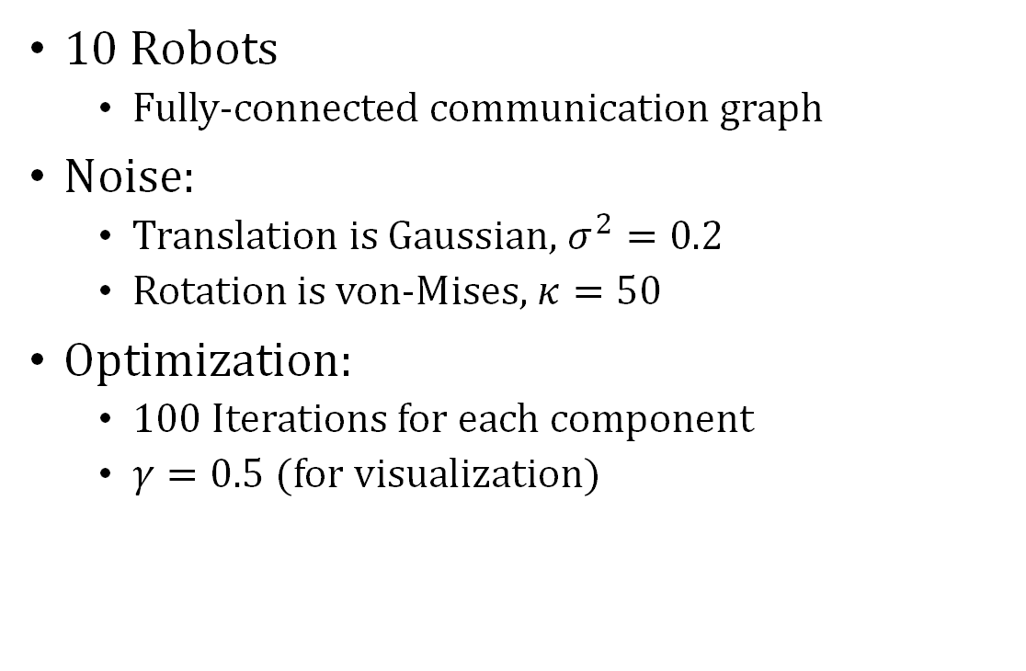
Results: PGO – High Noise
10 Robots
Fully-connected communication graph
Noise:
Translation is Gaussian, $σ^{2}=0.2$
Rotation is von-Mises, $κ=50$
Optimization:
100 Iterations for each component
$γ=0.5$(for visualization)

Slide 48
Results: PGO – High Noise
10 Robots
Fully-connected communication graph
Noise:
Translation is Gaussian, $σ^{2}=0.2$
Rotation is von-Mises, $κ=50$
Optimization:
100 Iterations for each component
$γ=0.5$(for visualization)

Slide 49
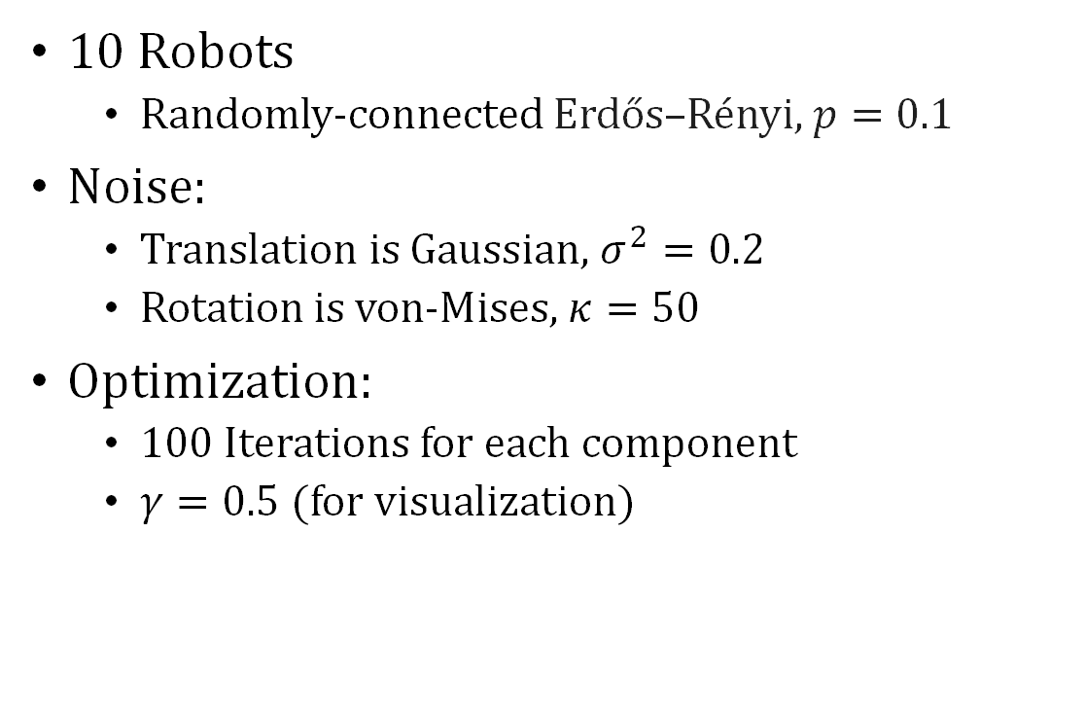
Results: PGO – High Noise
10 Robots
Randomly-connected Erdős–Rényi, $p=0.1$
Noise:
Translation is Gaussian, $σ^{2}=0.2$
Rotation is von-Mises, $κ=50$
Optimization:
100 Iterations for each component
$γ=0.5$(for visualization)

Slide 50

Results: PGO – Low Noise
10 Robots
Randomly-connected Erdős–Rényi, $p=0.1$
Noise:
Translation is Gaussian, $σ^{2}=0.1$
Rotation is von-Mises, $κ=1000$
Optimization:
100 Iterations for each component
$γ=0.2$(for visualization)

Slide 51
Integrating Point Clouds
We assign each robot a subset of a point cloud generated from a 2D scene
Point clouds are relative to local robot frames
Perform PGO as usual
We visualize the integrated point cloud maps

Slide 52
Point Cloud Results
4 Robots
Fully-connected communication graph

Slide 53
Point Cloud Results
10 Robots
Fully-connected communication graph
Medium noise

Slide 54
Point Cloud Results
10 Robots
Fully-connected communication graph
High noise

Slide 55
Point Cloud Results
10 Robots
Sparse communication graph (ER .01)
High noise

Slide 56
Questions?

